Slide 1
Final Project Weather APP
HTML, CSS, Javascript
Pauline ZHOU
Student ID : 202400396

Slide 2

Objectif
Create a responsive web application to monitor and display real-time air quality data

Slide 3
01
Inspiration
How I begin the Website

Slide 4
Inspiration
Google
Youtube
ChatGPT
Design
Design and structure
Structure

Slide 5

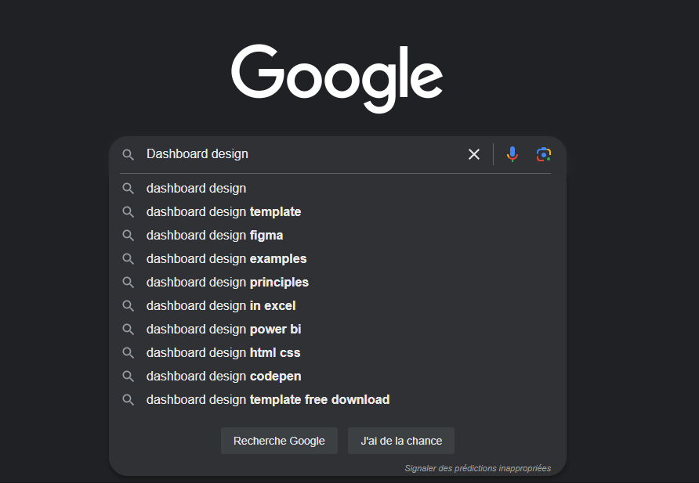
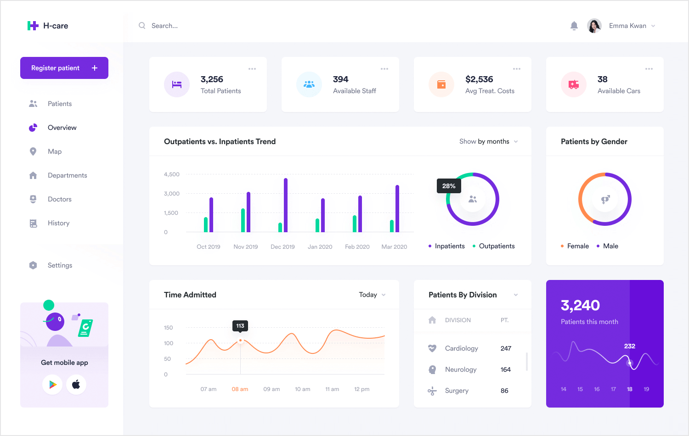
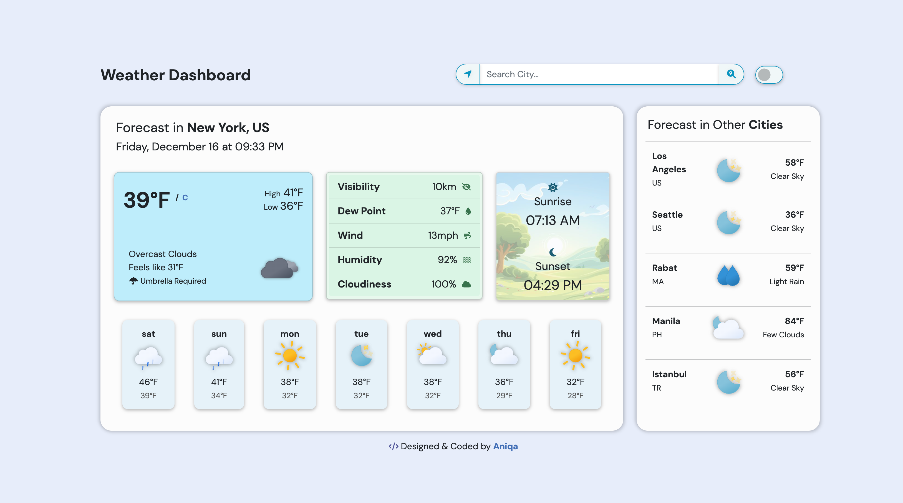
Google

Slide 6
Inspiration
Google
Youtube
ChatGPT
Design
Design and structure
Structure

Slide 7
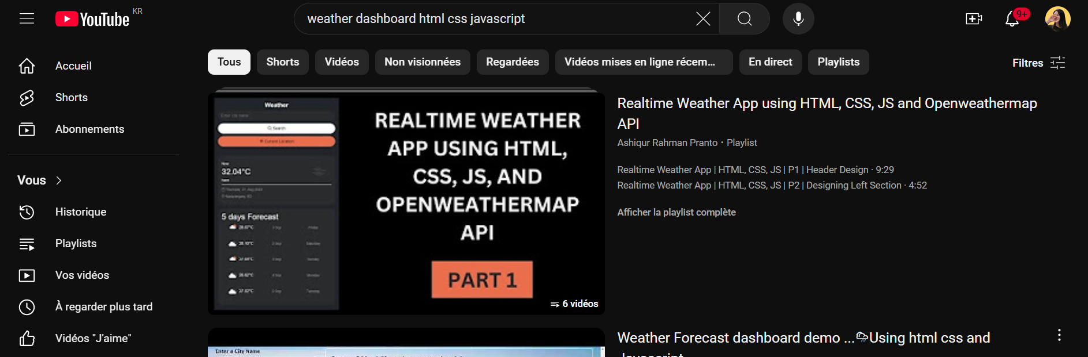
Youtube

Slide 8

Inspiration
Google
Youtube
ChatGPT
Design
Design and structure
Structure

Slide 9
Features dones
02
how much work has been done so far

Slide 10

Features Done
Navigation bar
Search Bar
Footer
Data Display
Data Visualisation
Real-Time data
With different page
Search different city
copyright information, links
Temperature, winder speed, humidity, Air quality index, …
Line chart, Bar chart, Dougnut chart
API : Openweather

Slide 11
Weather of different cities
Paris
Canada
Busan
… … …
ETC

Slide 12
Features Done
Navigation bar
Search Bar
Footer
Data Display
Data Visualisation
Real-Time data
With different page
Search different city
copyright information, links
Temperature, winder speed, humidity, Air quality index, …
Line chart, Bar chart, Dougnut chart
API : Openweather

Slide 13

Home Page
Main Dashboard

Slide 14
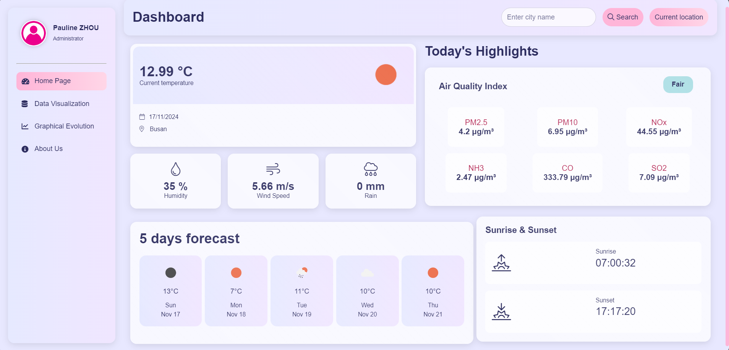
Navigation Bar

Slide 15
Search Bar

Slide 16
Footer

Slide 17

Main Dashboard

Slide 18
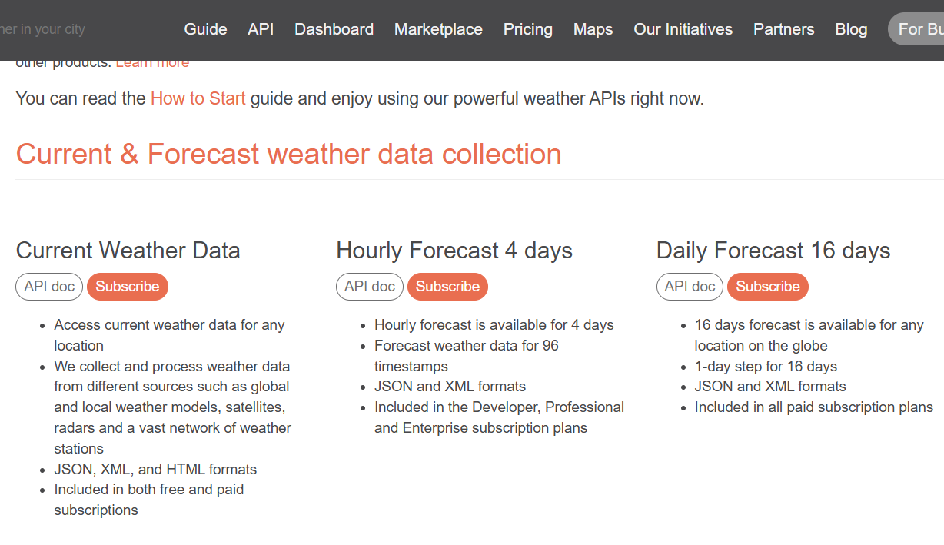
Real Time : use API key
OpenWeather Website

Slide 19
Temperature

Slide 20
Humidity, Wind speed, Rain

Slide 21
Air quality index

Slide 22
Pollution Data Display

Slide 23
Sunrise-Sunset

Slide 24
Weather forecast for the next 5 days

Slide 25
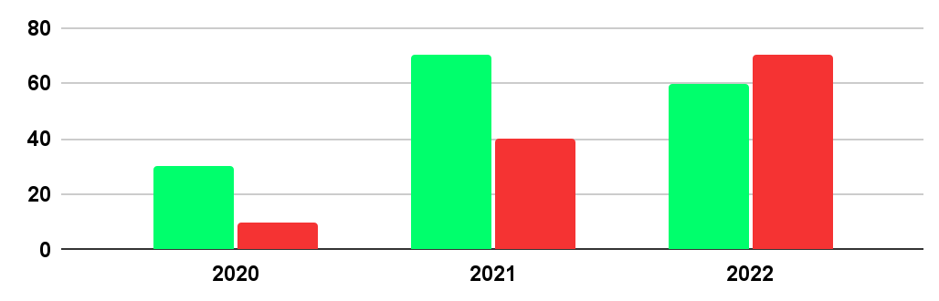
Data Visualisation
16-20
21-30
31-40
40%
30%
20%

Slide 26
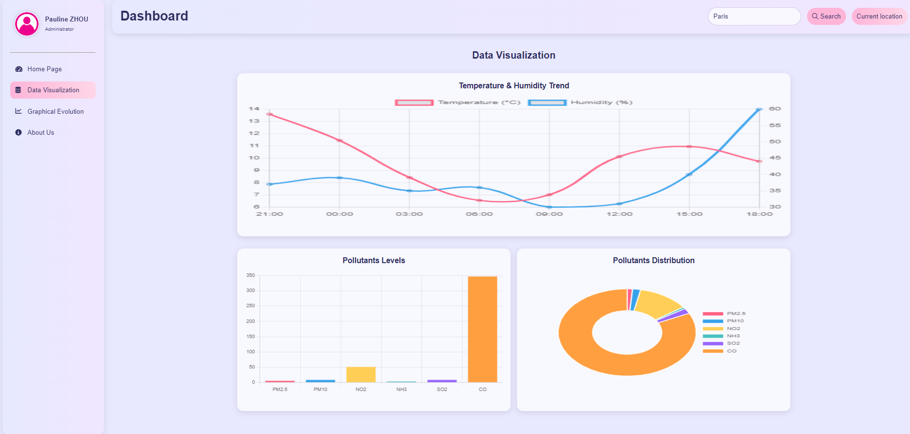
Line chart

Slide 27
Bar chart

Slide 28
Doughnut chart

Slide 29
About Us

Slide 30
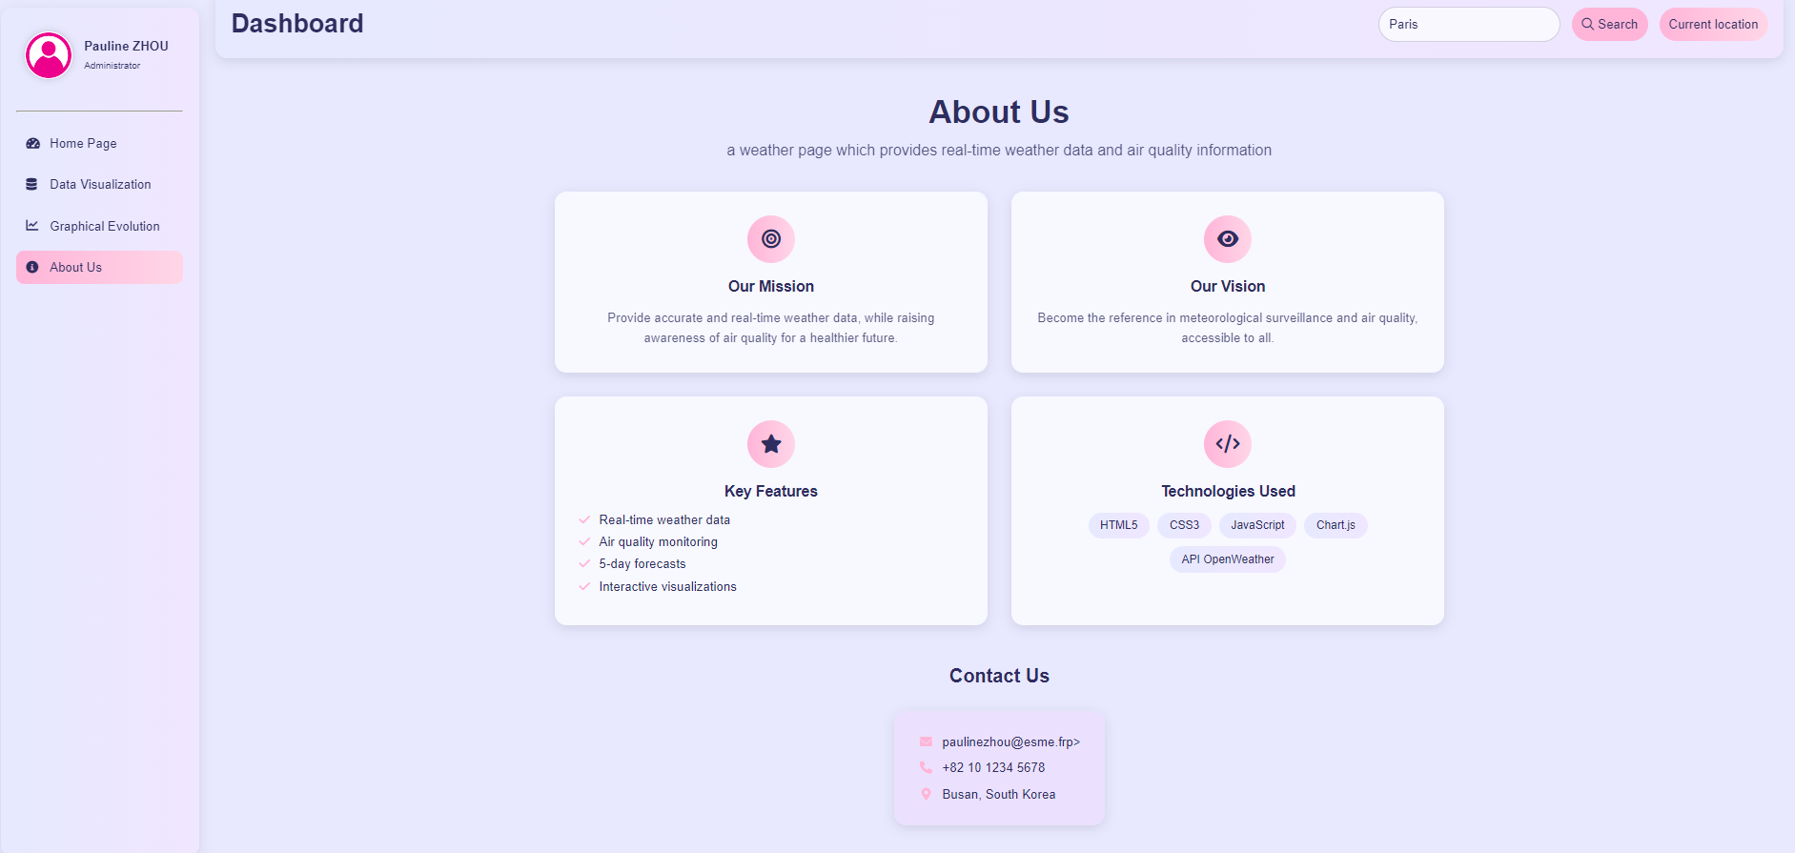

Slide 31
Features to be completed
03
What I will do later

Slide 32
Future features
Current Location
Get the user localisation
Update Data Visualisation
Remove old canvas to update new canvas
Graphical Evolution
Show graph evolution for temperature, humitidy, air quality index and wind speed

Slide 33
Current Location
Update the current location

Slide 34
Future features
Current Location
Get the user localisation
Update Data Visualisation
Remove old canvas to update new canvas
Graphical Evolution
Show graph evolution for temperature, humitidy, air quality index and wind speed

Slide 35
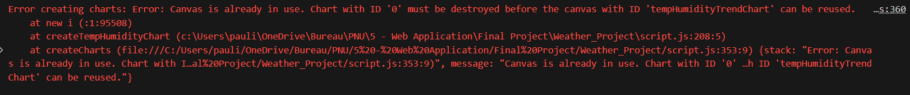
Update Data Visualisation
Update graph when we change the city

Slide 36
Future features
Current Location
Get the user localisation
Update Data Visualisation
Remove old canvas to update new canvas
Graphical Evolution
Show graph evolution for temperature, humitidy, air quality index and wind speed

Slide 37
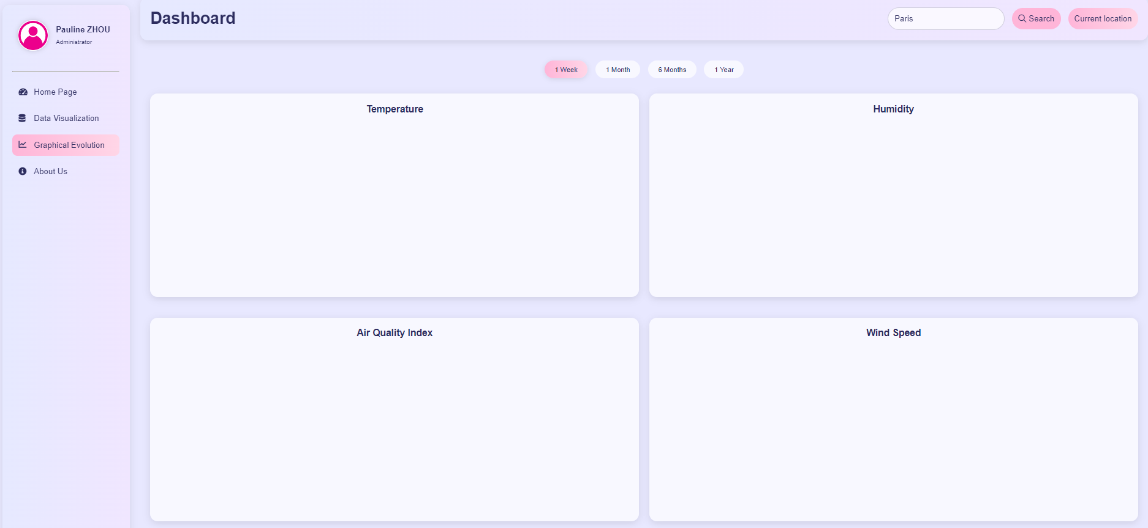
Graphical Evolution
During 1 week
Graph evolution over time

Slide 38
During 1 month
Graph evolution over time

Slide 39
During 6 months
Graph evolution over time

Slide 40
During 1 year
Graph evolution over time

Slide 41
Thanks you !
Do you have any questions?
pauline.zhou@esme.fr

Slide 42
Contents of this website
Modern concept | CSS variables, flexbox, grid, transitions, media queries
Alternative resources | Profile.jpg
API | https://openweathermap.org/api
Colors | Pastel colors : pink, blue and purple / linear-gradient
Chart.js | https://cdnjs.cloudflare.com/ajax/libs/Chart.js/4.4.1/chart.umd.min.js
Icons | https://unpkg.com/boxicons@2.1.4/dist/boxicons.min.css

